Slide 1


CSE 470/598 Texture Mapping
Ross Maciejewski
rmacieje@asu.edu

Slide 2
Disclaimer
These slides can only be used as study material for the class 470 at ASU
The slides cannot be distributed or used for another purpose

Slide 3
Objectives
Introduce mapping methods
Texture Mapping
Environment Mapping
Bump Mapping
Consider basic strategies
Forward vs backward mapping
Point sampling vs area averaging

Slide 4
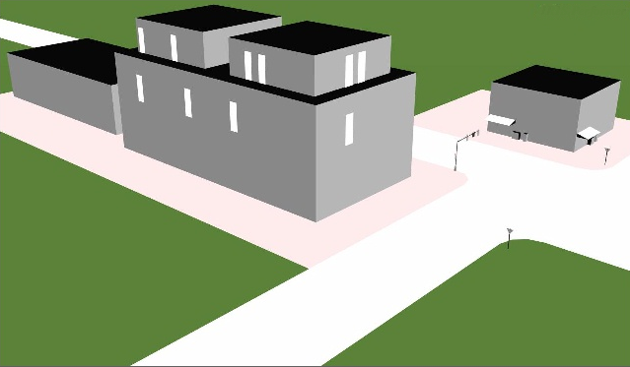
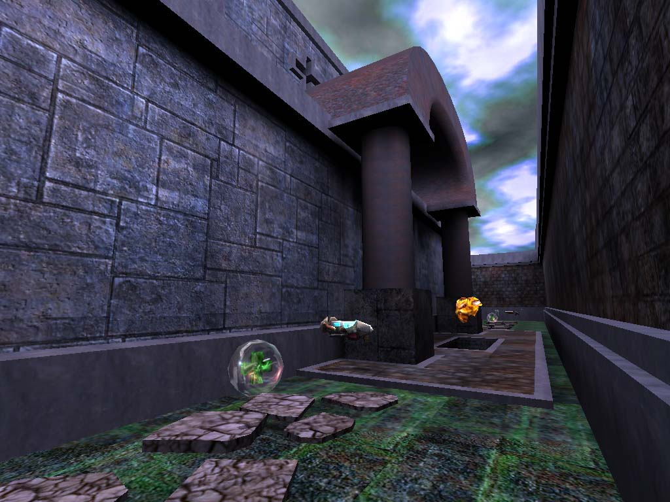
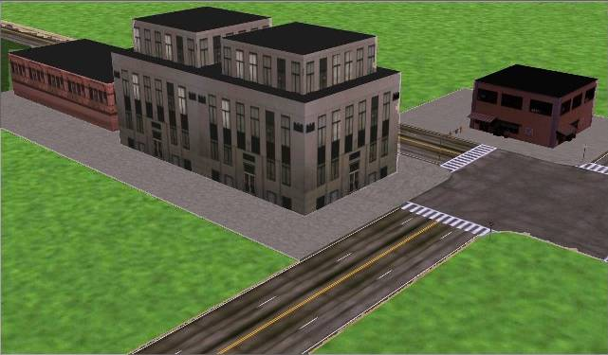
Why Texturing?
Eduard Gröller, Stefan Jeschke
4
Idea: enhance visual appearance of plain surfaces by applying fine structured details

Slide 5
The Limits of Geometric Modeling
Although graphics cards can render over 10 million polygons per second, that number is insufficient for many phenomena
Clouds
Grass
Terrain
Skin

Slide 6
Modeling an Orange
Consider the problem of modeling an orange (the fruit)
Start with an orange-colored sphere
Too simple
Replace sphere with a more complex shape
Does not capture surface characteristics (small dimples)
Takes too many polygons to model all the dimples

Slide 7
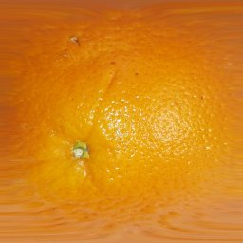
Modeling an Orange (2)
Take a picture of a real orange, scan it, and “paste” onto simple geometric model
This process is known as texture mapping
Still might not be sufficient because resulting surface will be smooth
Need to change local shape
Bump mapping

Slide 8
Three Types of Mapping
Texture Mapping
Uses images to fill inside of polygons
Environment (reflection mapping)
Uses a picture of the environment for texture maps
Allows simulation of highly specular surfaces
Bump mapping
Emulates altering normal vectors during the rendering process

Slide 9
Types of Textures
Spatial Layout
1D, 2D, 3D
Cube Maps
To start out you mainly use 2D textures
Texel – one “pixel” of a texture

Slide 10
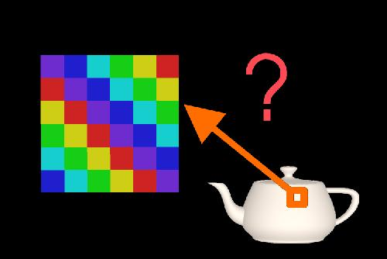
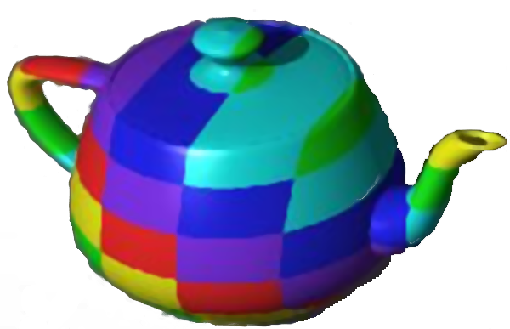
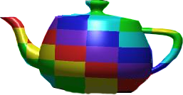
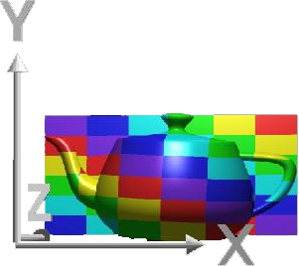
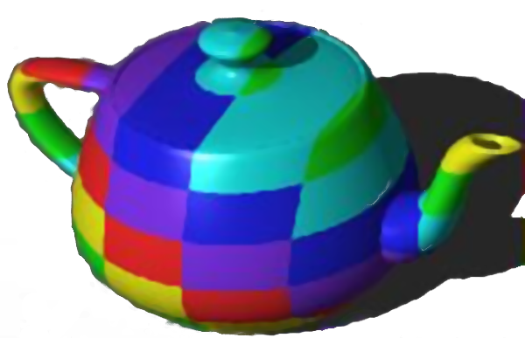
Texturing: General Approach
Texels
Texture space (u,v)
Object space (x_{O},y_{O},z_{O})
Image Space (x_{I},y_{I})
Parametrization
Rendering
(Projection etc.)

Slide 11
Texture Spaces
Modeling
Rendering
Object space (x,y,z,w)
Texture projection
Parameter Space (s,t,r,q)
Texture function
Texture Space (u,v)

Slide 12
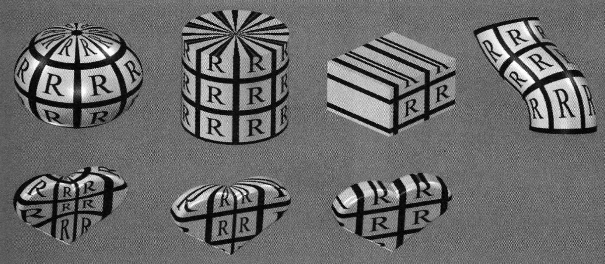
Texture Projectors
Where do texture coordinates come from?
Online: texture matrix (often low quality!)
Offline: typically by a modeling program
spherical cylindrical planar natural

Slide 13
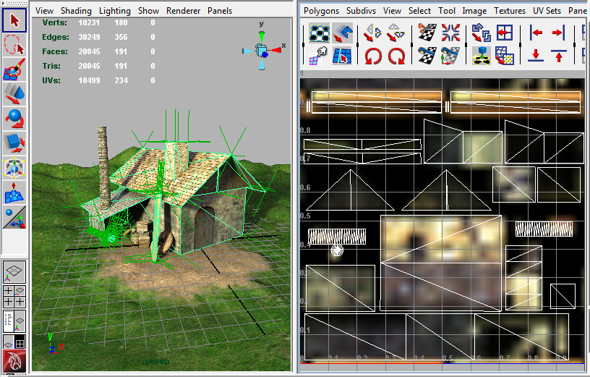
Texture Projectors
Where do texture coordinates come from?
Offline: manual UV coordinates by DCC program
Note: a modeling Problem!

Slide 14
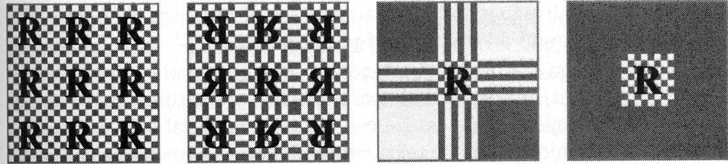
Texture Functions
How to extend texture beyond the border?
Border and repeat/clamp modes
Arbitrary (s,t,…) → [0,1] → [0,255]x[0,255]
repeat mirror/repeat clamp border

Slide 15
Texturing
Problem Minification: One pixel in image space can cover many texels
Terms:
Aliasing – term from signal processing
Undersampling – intuitive term
Anti-aliasing – method to combat aliasing

Slide 16
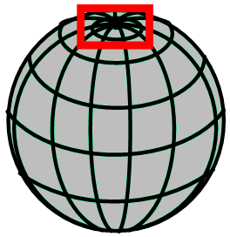
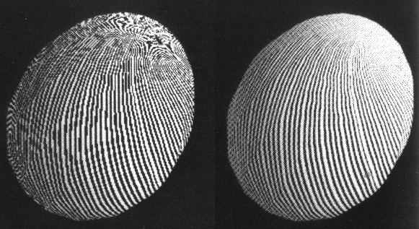
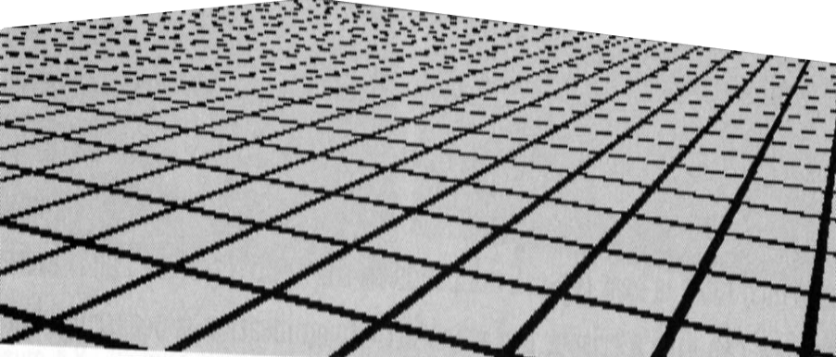
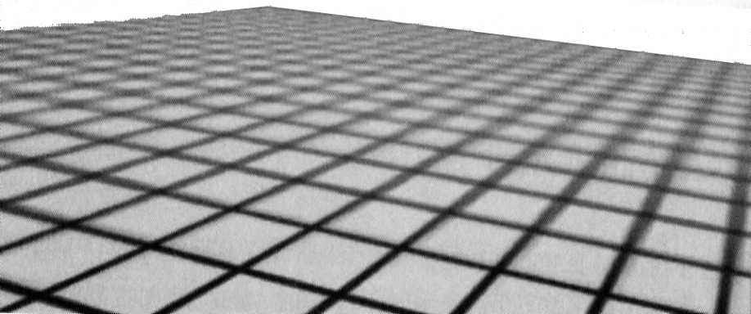
Texture Aliasing - Undersampling

Slide 17
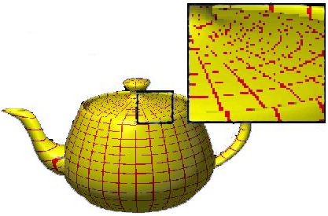
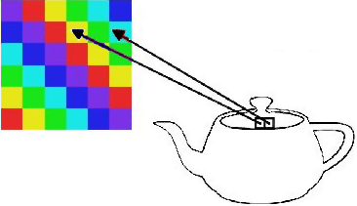
Texture Aliasing - Undersampling
Caused by undersampling: texture information is lost
Texture space
Image space
Eduard Gröller, Stefan Jeschke
17

Slide 18
Texture Anti-Aliasing
v
Pixel
X
X
Texture space
u
Image space
Eduard Gröller, Stefan Jeschke
18
A good pixel value is the weighted mean of the pixel area projected into texture space

Slide 19
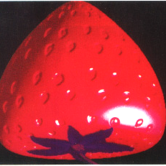

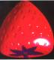

Texture Anti-Aliasing: MIP Mapping
Distance
Eduard Gröller, Stefan Jeschke
MIP Mapping (“Multum In Parvo”)
Texture size is reduced by factors of 2 (downsampling = "much info on a small area")
Simple (4 pixel average) and memory efficient
Last image is only ONE texel

Slide 20
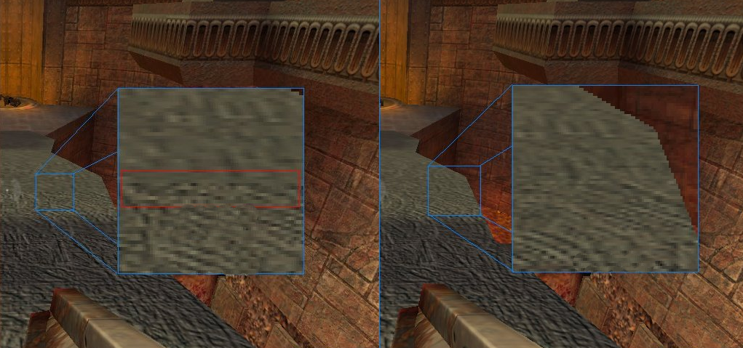
Texture Anti-Aliasing: MIP Mapping
MIP Mapping Algorithm
D := ld(max(d₁,d₂))
T₀ := value from texture D₀= trunc (D)
Use bilinear interpolation
d₂
"Mip Map level"
d₁
X
Bilinear interpolation
Trilinear interpolation
Eduard Gröller, Stefan Jeschke
20
Notes:
20
Bilinear: no interpolation between different levels
Trilinear: also interpolation between different levels

Slide 21
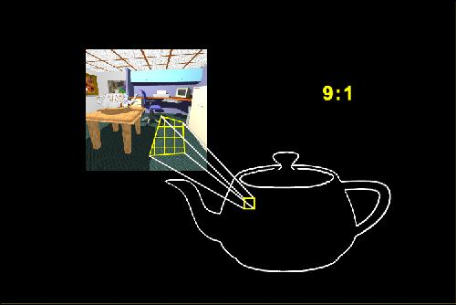
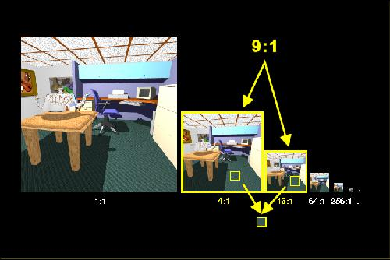
Texture Anti-Aliasing: MIP Mapping
Trilinear interpolation:
T₁ := value from texture D₁ = D₀+1 (bilin.interpolation)
Pixel value := (D₁–D)·T₀ + (D–D₀)·T₁
Linear interpolation between successive MIP Maps
Avoids "Mip banding" (but doubles texture lookups)
Eduard Gröller, Stefan Jeschke
21

Slide 22
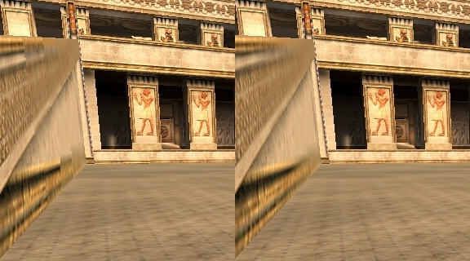
Texture Anti-Aliasing: Mip Mapping
Eduard Gröller, Stefan Jeschke
Other example for bilinear vs. trilinear filtering

Slide 23
Magnification
Problem Magnification: a large area in screen space is only covered by a few texels
Solution:
high quality: smooth interpolation with bilinear filtering
low quality: nearest neighbor filtering

Slide 24



Anti-Aliasing (Bilinear Filtering Example)
Original image
Nearest neighbor
Bilinear filtering
Eduard Gröller, Stefan Jeschke

Slide 25
Important Note
Interpolation parameters have to be set for minification and magnification!
Example Minification (high quality):
Use mip-mapping
+ linear interpolation between mipmaps
+ bilinear-filtering for each mip-map level

Slide 26
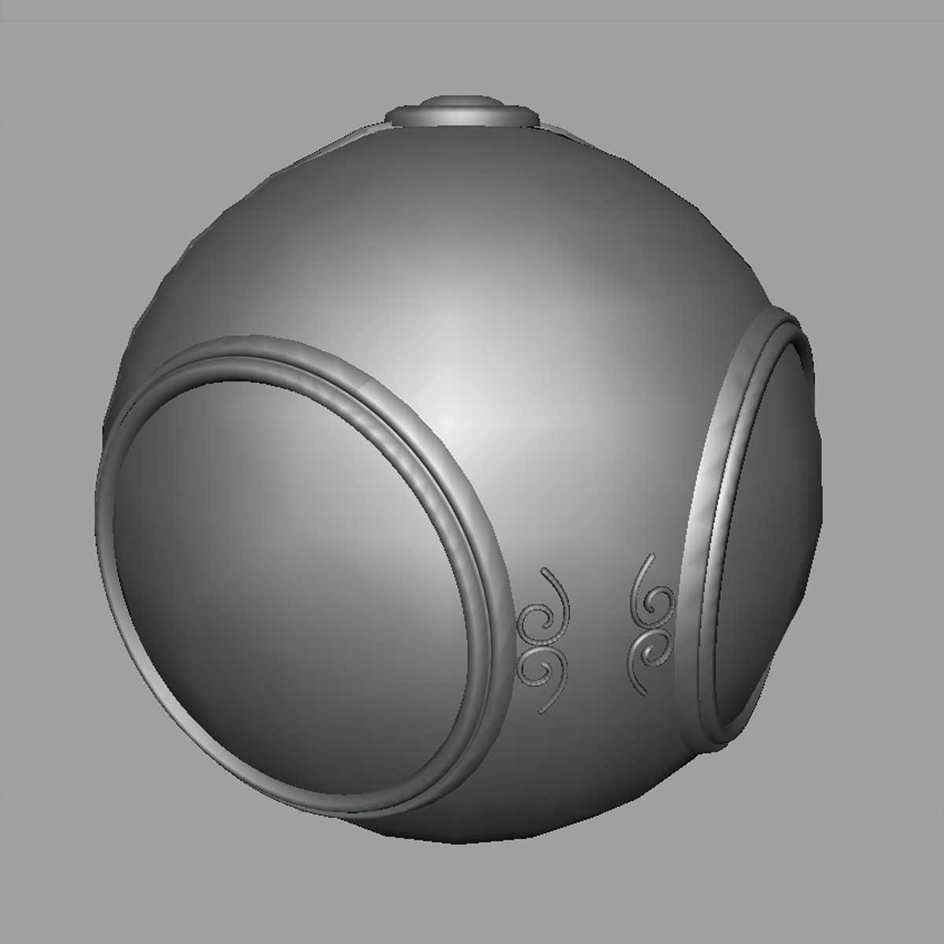

Texture Mapping
geometric model
texture mapped

Slide 27
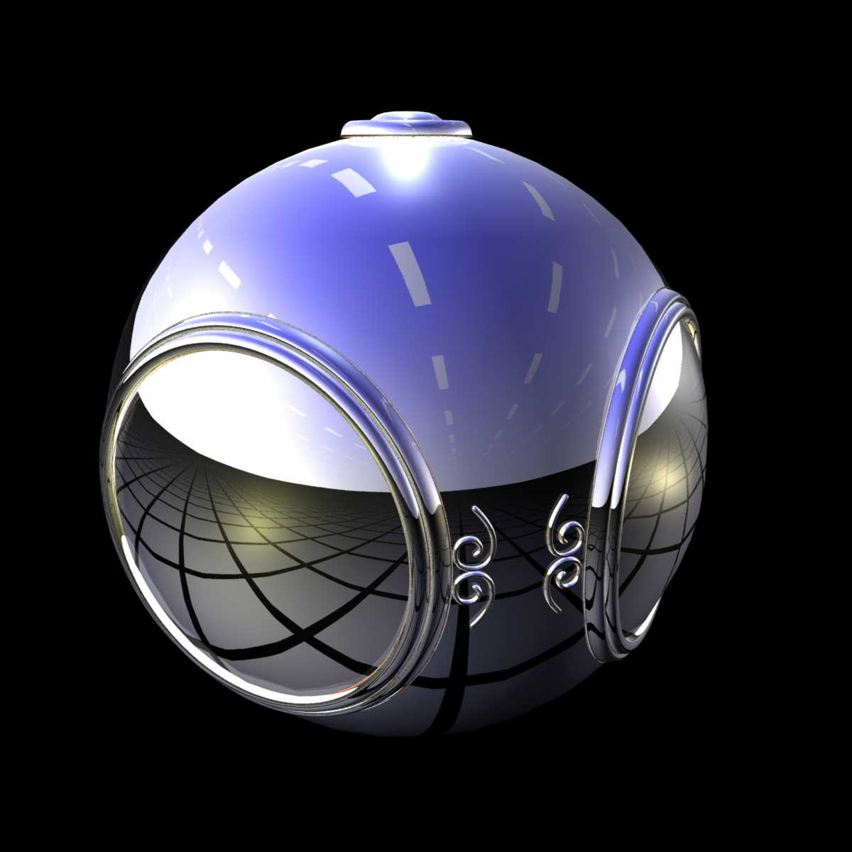
Environment Mapping

Slide 28
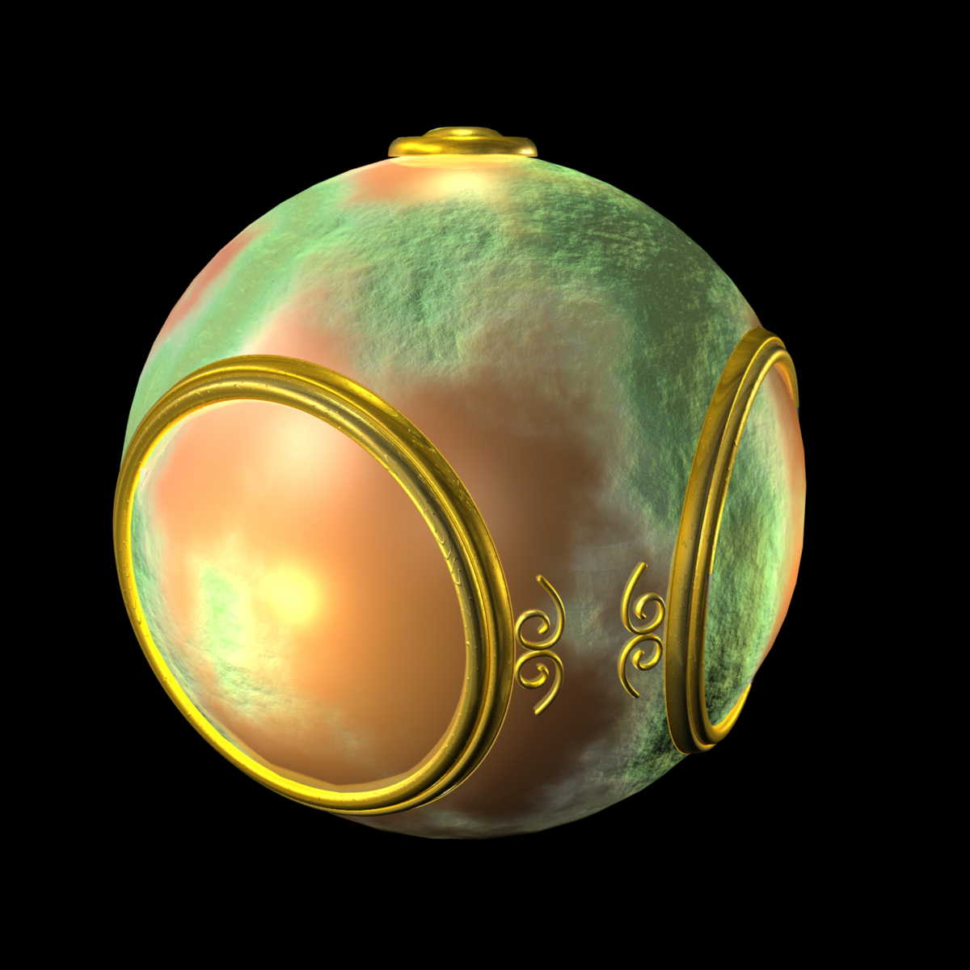
Bump Mapping

Slide 29
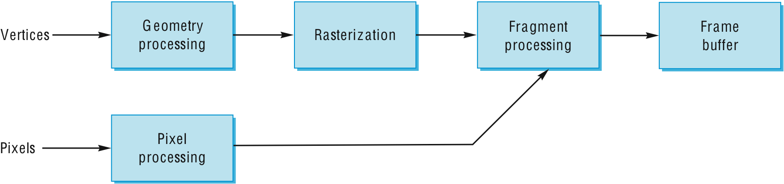
Where does mapping take place?
Mapping techniques are implemented at the end of the rendering pipeline
Very efficient because few polygons make it past the clipper

Slide 30
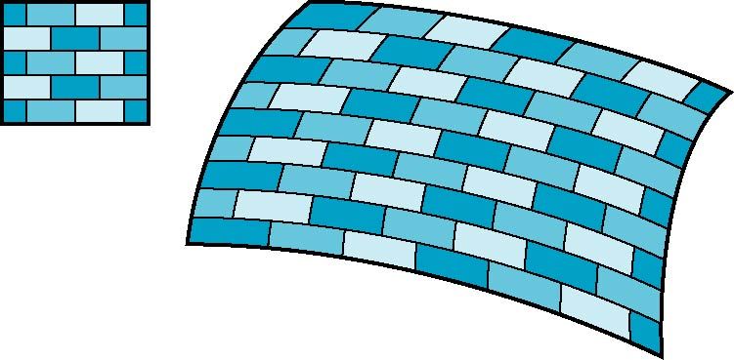
Is it simple?
Although the idea is simple---map an image to a surface---there are 3 or 4 coordinate systems involved
2D image
3D surface

Slide 31
Coordinate Systems
Parametric coordinates
May be used to model curves and surfaces
Texture coordinates
Used to identify points in the image to be mapped
Object or World Coordinates
Conceptually, where the mapping takes place
Window Coordinates
Where the final image is really produced

Slide 32
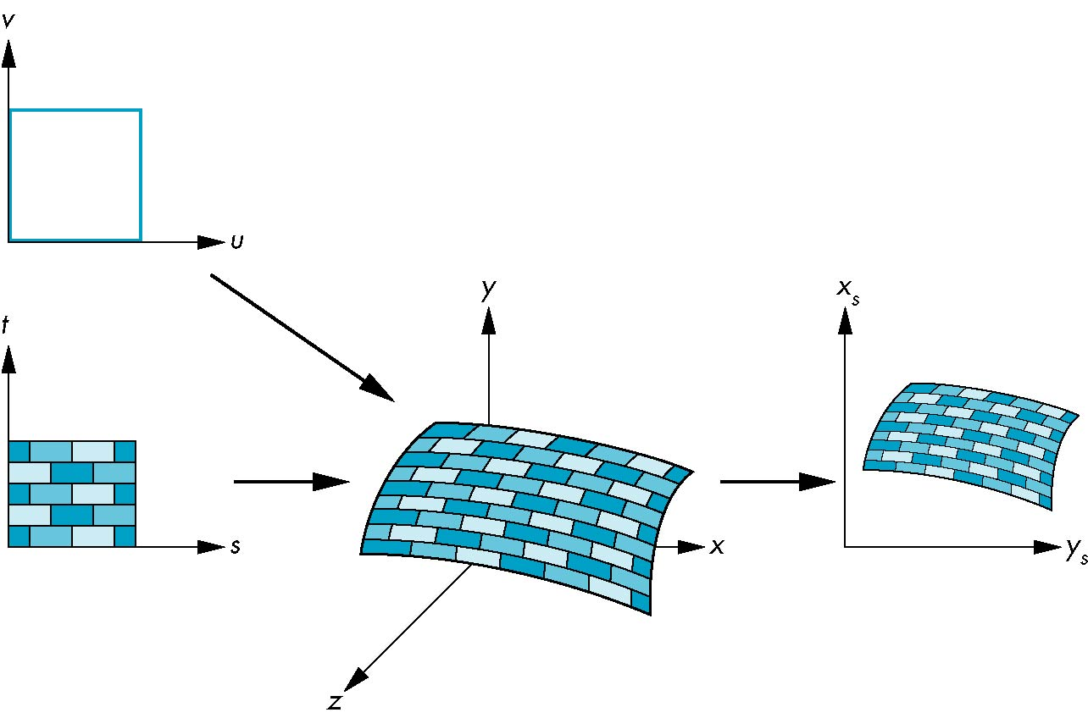
Texture Mapping
parametric coordinates
texture coordinates
window coordinates
world coordinates

Slide 33
Mapping Functions
Basic problem is how to find the maps
Consider mapping from texture coordinates to a point a surface
Appear to need three functions
x = x(s,t)
y = y(s,t)
z = z(s,t)
But we really want to go the other way
(x,y,z)
t
s

Slide 34
Backward Mapping
We really want to go backwards
Given a pixel, we want to know to which point on an object it corresponds
Given a point on an object, we want to know to which point in the texture it corresponds
Need a map of the form
s = s(x,y,z)
t = t(x,y,z)
Such functions are difficult to find in general

Slide 35
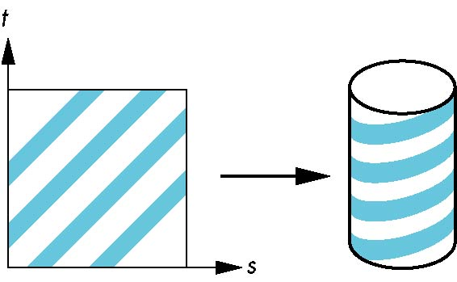
Two-part mapping
One solution to the mapping problem is to first map the texture to a simple intermediate surface
Example: map to cylinder

Slide 36
Cylindrical Mapping
parametric cylinder
x = r cos 2π u
y = r sin 2πu
z = v/h
maps rectangle in u,v space to cylinder
of radius r and height h in world coordinates
s = u
t = v
maps from texture space

Slide 37
Spherical Map
We can use a parametric sphere
x = r cos 2πu
y = r sin 2πu cos 2πv
z = r sin 2πu sin 2πv
in a similar manner to the cylinder
but have to decide where to put
the distortion
Spheres are used in environmental maps

Slide 38
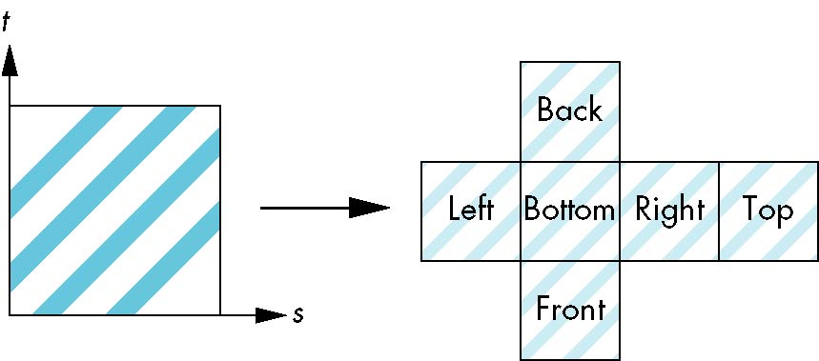
Box Mapping
Easy to use with simple orthographic projection
Also used in environment maps

Slide 39
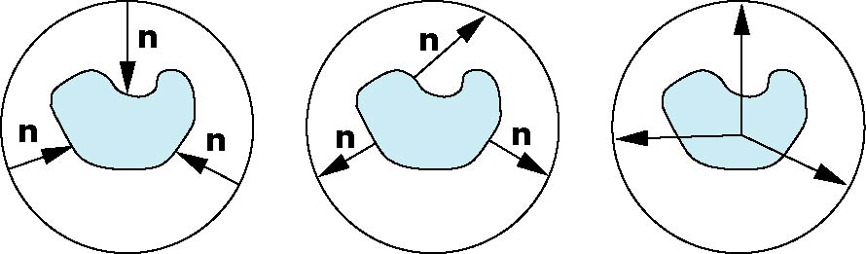
Second Mapping
Map from intermediate object to actual object
Normals from intermediate to actual
Normals from actual to intermediate
Vectors from center of intermediate
actual
intermediate

Slide 40
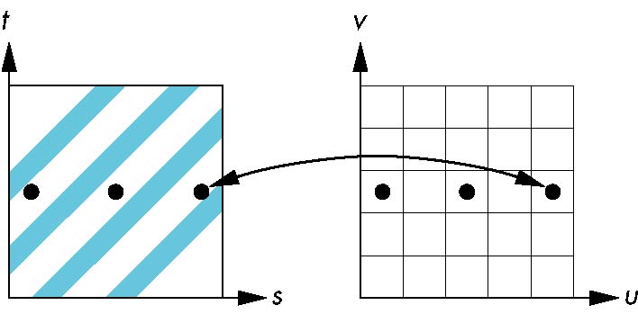
Aliasing
Point sampling of the texture can lead to aliasing errors
miss blue stripes
point samples in u,v
(or x,y,z) space
point samples in texture space

Slide 41
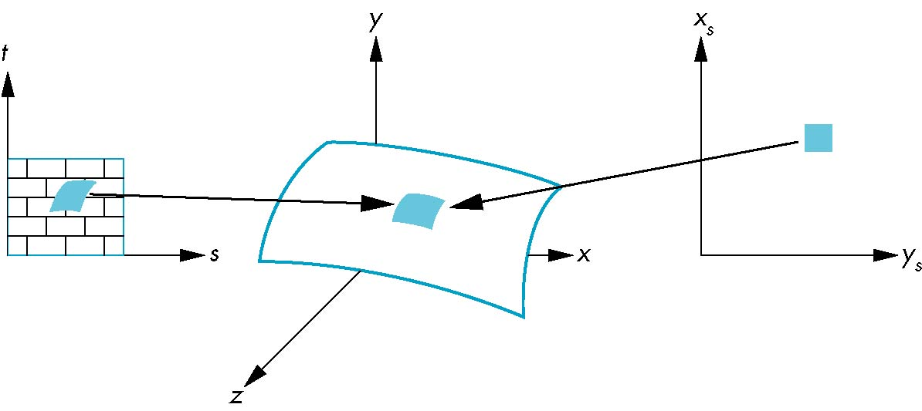
Area Averaging
A better but slower option is to use area averaging
pixel
preimage
Note that preimage of pixel is curved

Slide 42
Recap – Buffers and Textures
Framebuffer has several components beyond color data
Bitmaps and pixmaps
3 types of mapping operations:
Texture/environment/bump mapping
Why use mapping operations?
Mapping: going “the other way”
Screen pixel -> object point -> texture pixel (texel)
Mapping functions for intermediate objects

Slide 43
Texture Mapping in OpenGL

Slide 44
Objectives
Introduce texture mapping in OpenGL
Basic procedure and background
Perspective correction
Hints and parameters
Texture objects
Advanced topics

Slide 45
Basic Strategy
Three steps to applying a texture
specify the texture
read or generate image
assign to texture
enable texturing
assign texture coordinates to vertices
Proper mapping function is left to application
specify texture parameters
wrapping, filtering

Slide 46
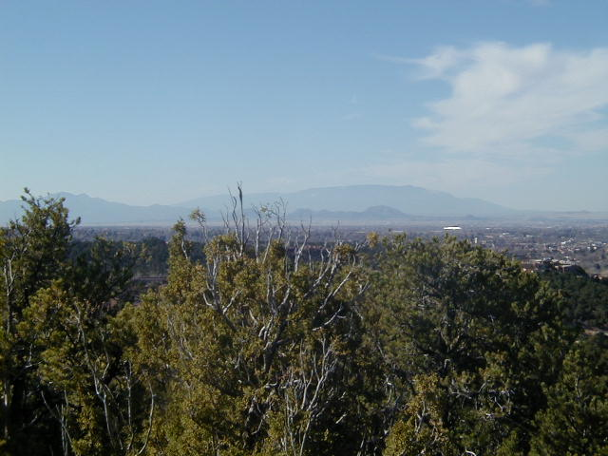
Texture Mapping
y
z
x
geometry
display
t
image
s

Slide 47
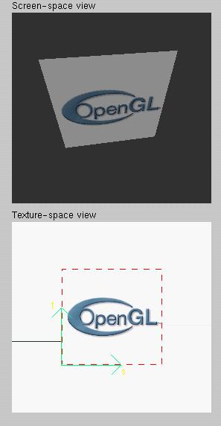
Texture Example
The texture (below) is a 256 x 256 image that has been mapped to a rectangular polygon which is viewed in perspective

Slide 48
Texture Mapping and the OpenGL Pipeline
Images and geometry flow through separate pipelines that join during fragment processing
“complex” textures do not affect geometric complexity
vertices
geometry pipeline
fragmentprocessor
image
pixel pipeline

Slide 49
Specifying a Texture Image
Define a texture image from an array of texels (texture elements) in CPU memory
Glubyte my_texels[512][512];
Define as any other pixel map
Scanned image
Generate by application code
Enable texture mapping
glEnable(GL_TEXTURE_2D)
OpenGL supports 1-4 dimensional texture maps

Slide 50
Define Image as a Texture
glTexImage2D(target, level, components, w, h, border, format, type, texels);
target: type of texture, e.g. GL_TEXTURE_2D
level: used for mipmapping (discussed later)
components: elements per texel
w, h: width and height of texels in pixels
border: used for smoothing (discussed later)
format and type: describe texels
texels: pointer to texel array
glTexImage2D(GL_TEXTURE_2D, 0, 3, 512, 512, 0, GL_RGB, GL_UNSIGNED_BYTE, my_texels);

Slide 51
Converting A Texture Image
OpenGL used to require texture dimensions to be powers of 2
No longer necessary for modern graphics cards
If dimensions of image are not powers of 2
gluScaleImage( format, w_in, h_in, type_in, *data_in, w_out, h_out, type_out, *data_out );
data_in is source image
data_out is for destination image
Image interpolated and filtered during scaling
Notes:
If

Slide 52
Mapping a Texture
Based on parametric texture coordinates
glTexCoord*() specified at each vertex
Texture Space
Object Space
t
1, 1
(s, t) = (0.2, 0.8)
0, 1
A
a
c
(0.4, 0.2)
b
B
C
0, 0
1, 0
s
(0.8, 0.4)

Slide 53
Typical Code
glBegin(GL_POLYGON);
glColor3f(r0, g0, b0); //if no shading used
glNormal3f(u0, v0, w0); // if shading used
glTexCoord2f(s0, t0);
glVertex3f(x0, y0, z0);
glColor3f(r1, g1, b1);
glNormal3f(u1, v1, w1);
glTexCoord2f(s1, t1);
glVertex3f(x1, y1, z1);
.
.
glEnd();
Note that we can use vertex arrays to increase efficiency

Slide 54
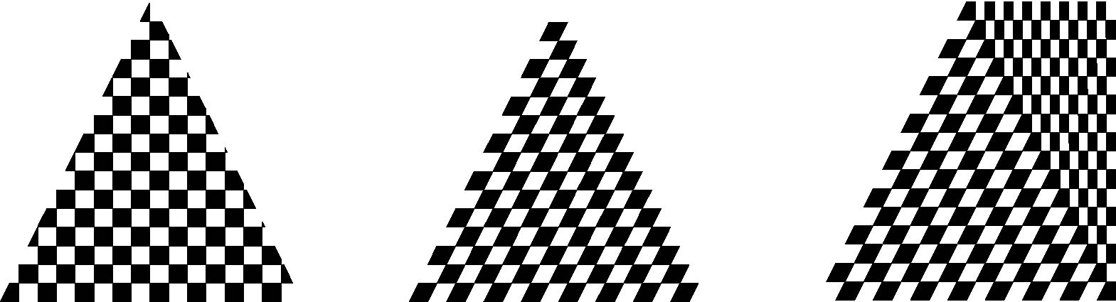
Interpolation
OpenGL uses interpolation to find proper texels from specified texture coordinates
Can be distortions
texture stretched
over trapezoid
showing effects of
bilinear interpolation
good selection
of tex coordinates
poor selection
of tex coordinates

Slide 55
Texture Parameters
OpenGL has a variety of parameters that determine how texture is applied
Wrapping parameters determine what happens if s and t are outside the (0,1) range
Filter modes allow us to use area averaging instead of point samples
Mipmapping allows us to use textures at multiple resolutions
Environment parameters determine how texture mapping interacts with shading

Slide 56
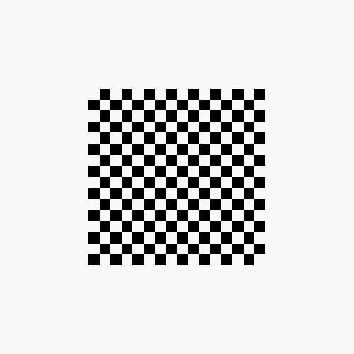
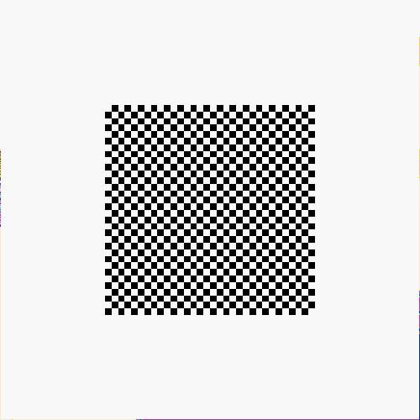

Wrapping Mode
Clamping: if s,t > 1 use 1, if s,t <0 use 0
Wrapping: use s,t modulo 1
glTexParameteri( GL_TEXTURE_2D, GL_TEXTURE_WRAP_S, GL_CLAMP )
glTexParameteri( GL_TEXTURE_2D, GL_TEXTURE_WRAP_T, GL_REPEAT )
t
s
GL_REPEAT
wrapping
GL_CLAMP
wrapping
texture

Slide 57
Magnification and Minification
More than one texel can cover a pixel (minification) or
more than one pixel can cover a texel (magnification)
Can use point sampling (nearest texel) or linear filtering
( 2 x 2 filter) to obtain texture values
Texture
Polygon
Texture
Polygon
Magnification
Minification

Slide 58
Filter Modes
Modes determined by
glTexParameteri( target, type, mode )
glTexParameteri(GL_TEXTURE_2D, GL_TEXURE_MAG_FILTER,
GL_NEAREST);
glTexParameteri(GL_TEXTURE_2D, GL_TEXURE_MIN_FILTER,
GL_LINEAR);
Note that linear filtering requires a border of an
extra texel for filtering at edges (border = 1)

Slide 59
Mipmapped Textures
Mipmapping allows for prefiltered texture maps of decreasing resolutions
Lessens interpolation errors for smaller textured objects
Declare mipmap level during texture definition
glTexImage2D( GL_TEXTURE_*D, level, … )
GLU mipmap builder routines will build all the textures from a given image
gluBuild*DMipmaps( … )

Slide 60
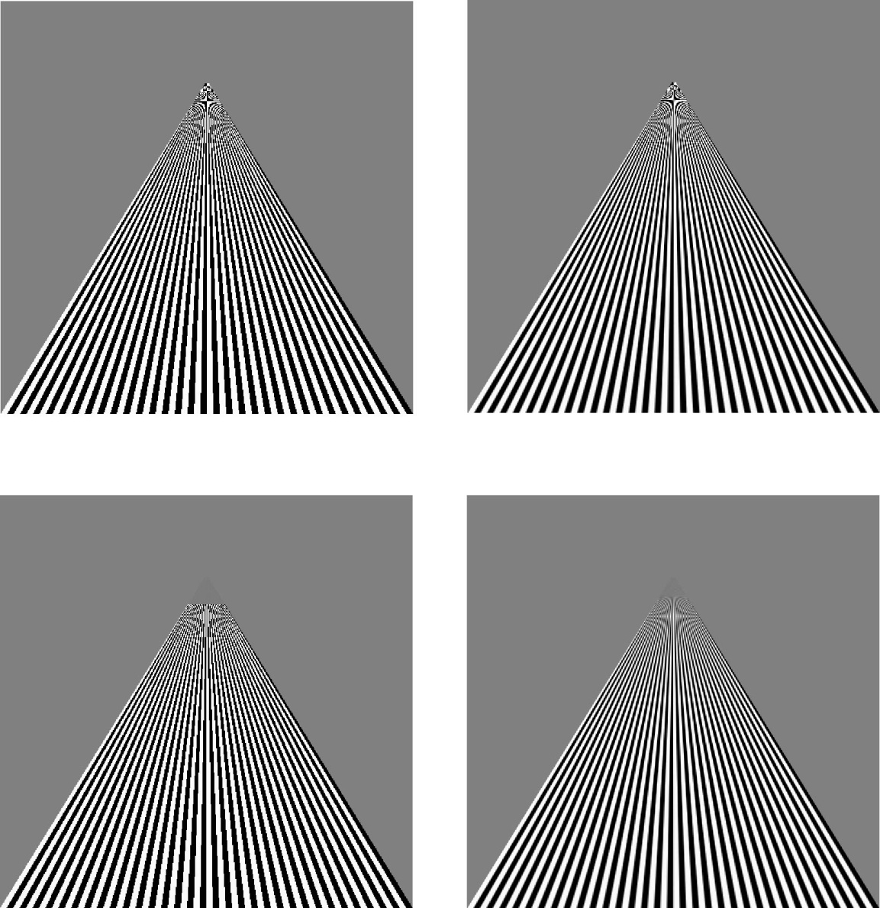
Example
point
sampling
linear
filtering
mipmapped
point
sampling
mipmapped
linear
filtering

Slide 61
Texture Functions
Controls how texture is applied
glTexEnv{fi}[v]( GL_TEXTURE_ENV, prop, param )
GL_TEXTURE_ENV_MODE modes
GL_MODULATE: modulates with computed shade
GL_BLEND: blends with an environmental color
GL_REPLACE: use only texture color
GL(GL_TEXTURE_ENV, GL_TEXTURE_ENV_MODE, GL_MODULATE);
Set blend color with GL_TEXTURE_ENV_COLOR

Slide 62
Perspective Correction Hint
Texture coordinate and color interpolation
either linearly in screen space
or using depth/perspective values (slower)
Noticeable for polygons “on edge”
glHint(GL_PERSPECTIVE_CORRECTION_HINT, hint)
where hint is one of
GL_DONT_CARE
GL_NICEST
GL_FASTEST

Slide 63
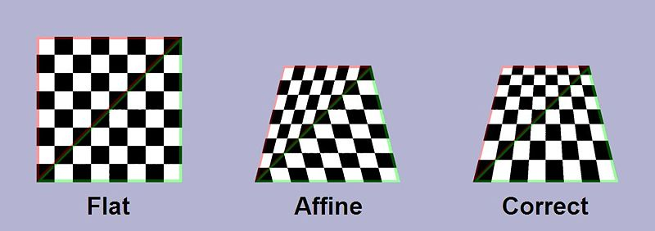
Example: Perspective Correction

Slide 64
Generating Texture Coordinates
OpenGL can generate texture coordinates automatically
glTexGen{ifd}[v]()
specify a plane
generate texture coordinates based upon distance from the plane
generation modes
GL_OBJECT_LINEAR
GL_EYE_LINEAR
GL_SPHERE_MAP (used for environmental maps)

Slide 65
Texture Objects
Texture is part of the OpenGL state
If we have different textures for different objects, OpenGL will be moving large amounts data from processor memory to texture memory
Recent versions of OpenGL have texture objects
one image per texture object
Texture memory can hold multiple texture objects

Slide 66
Applying Textures II
specify textures in texture objects
set texture filter
set texture function
set texture wrap mode
set optional perspective correction hint
bind texture object
enable texturing
supply texture coordinates for vertex
coordinates can also be generated

Slide 67
Other Texture Features
Environment Maps
Start with image of environment through a wide angle lens
Can be either a real scanned image or an image created in OpenGL
Use this texture to generate a spherical map
Use automatic texture coordinate generation
Multitexturing
Apply a sequence of textures through cascaded texture units

Slide 68
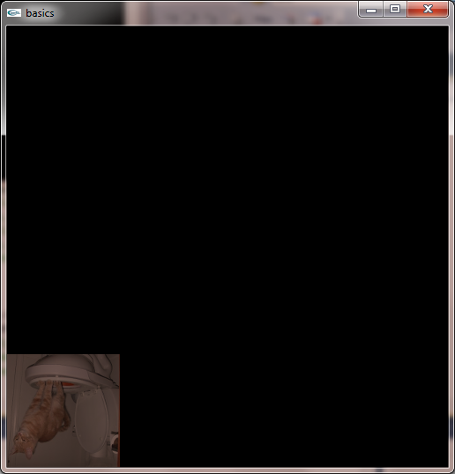

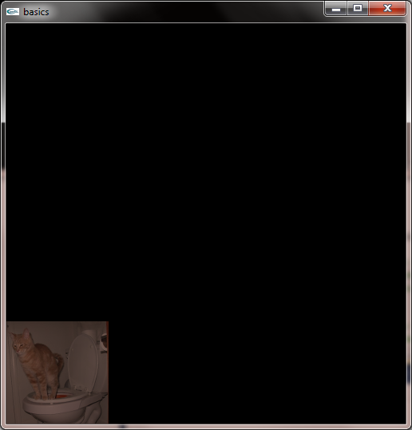

Example
/* the window will correspond to these world coorinates */
glOrtho(-1.0, 1.0, -1.0, 1.0, 0, 2.0);
//Code to test if the image is being drawn on the screen correctly
glRasterPos2i(-1,-1); //Why use -1, -1 ?
glDrawPixels(128,128,GL_RGB, GL_UNSIGNED_BYTE, image);

Slide 69
Generating and Binding a Texture ID
//The first thing that must take place in the process of uploading the texture is a call to glBindTexture.
//What glBindTexture does is it tells OpenGL which texture "id" we will be working with.
//A texture "id" is just a number that you will use to access your textures. Here is a sample call.
glBindTexture(GL_TEXTURE_2D, 13);
Normally, you will want to generate a texture ID and store it as a variable
void glGenTextures(GLsizei n, GLuint * textures);
glGenTextures returns n texture names in textures.
There is no guarantee that the names form a contiguous set of integers; however, it is guaranteed that none of the returned names was in use immediately before the call to glGenTextures.
The generated textures have no dimensionality; they assume the dimensionality of the texture target to which they are first bound

Slide 70
Defining the Texture
//The glPixelStorei call tells OpenGL how the data that is going to be uploaded is aligned.
//This call tells OpenGL that the pixel data which is going to be passed to it is aligned in byte order,
//this means that the data has one byte for each component, one for red, green and blue
glPixelStorei(GL_UNPACK_ALIGNMENT, 1);

Slide 71
glTexParameteri
glTexParameteri(GL_TEXTURE_2D, GL_TEXTURE_WRAP_S, GL_REPEAT);
glTexParameteri (GL_TEXTURE_2D, GL_TEXTURE_WRAP_T, GL_REPEAT);
glTexParameteri (GL_TEXTURE_2D, GL_TEXTURE_MAG_FILTER, GL_LINEAR);
glTexParameteri (GL_TEXTURE_2D, GL_TEXTURE_MIN_FILTER, GL_LINEAR);

Slide 72
GL_TEXTURE_MIN_FILTER
The texture minifying function is used whenever the pixel being textured maps to an area greater than one texture element. There are six defined minifying functions. Two of them use the nearest one or nearest four texture elements to compute the texture value. The other four use mipmaps.
A mipmap is an ordered set of arrays representing the same image at progressively lower resolutions. If the texture has dimensions 2nx2m there are max(n, m) + 1 mipmaps. The first mipmap is the original texture, with dimensions 2nx2m. Each subsequent mipmap has dimensions 2k1x2l1 where 2kx2l are the dimensions of the previous mipmap, until either k = 0 or l = 0. At that point, subsequent mipmaps have dimension 1x2l1 or 2k1x1 until the final mipmap, which has dimension 1x1. Mipmaps are defined using glTexImage1D or glTexImage2D with the level-of-detail argument indicating the order of the mipmaps. Level 0 is the original texture; level bold max(n, m) is the final 1x1 mipmap.

Slide 73
GL_TEXTURE_MAG_FILTER
The texture magnification function is used when the pixel being textured maps to an area less than or equal to one texture element. It sets the texture magnification function to either GL_NEAREST or GL_LINEAR.

Slide 74
GL_TEXTURE_WRAP_S
Sets the wrap parameter for texture coordinate s to either GL_CLAMP or GL_REPEAT. GL_CLAMP causes s coordinates to be clamped to the range [0,1] and is useful for preventing wrapping artifacts when mapping a single image onto an object. GL_REPEAT causes the integer part of the s coordinate to be ignored; OpenGL uses only the fractional part, thereby creating a repeating pattern. Border texture elements are accessed only if wrapping is set to GL_CLAMP. Initially, GL_TEXTURE_WRAP_S is set to GL_REPEAT.

Slide 75
GL_TEXTURE_WRAP_T
Sets the wrap parameter for texture coordinate t to either GL_CLAMP or GL_REPEAT. See the discussion under GL_TEXTURE_WRAP_S. Initially, GL_TEXTURE_WRAP_T is set to GL_REPEAT

Slide 76
glTexEnvf
//The glTexEnvf call sets environment variables for the current texture.
//What this does is tell OpenGL how the texture will act when it is rendered into a scene.
//What this does is sets the active texture to GL_MODULATE.
//The GL_MODULATE attribute allows you to apply effects such as lighting and coloring to your texture.
//If you do not want lighting and coloring to effect your texture and you would like to display the texture unchanged when
//coloring is applied replace GL_MODULATE with GL_DECAL.
glTexEnvf(GL_TEXTURE_ENV, GL_TEXTURE_ENV_MODE, GL_MODULATE);

Slide 77
glTexImage2D
void glTexImage2D(GLenum target, GLint level, GLint internalFormat, GLsizei width, GLsizei height, GLint border, GLenum format, GLenum type, const GLvoid * data)

Slide 78
glTexImage2d
/The glTexImage2D call is our goal.
//This call will upload the texture to the video memory where it will be ready for us to use in our programs.
//I am going to explain this call parameter by parameter since it is so important to what we are doing.
//target - The target of this call, it will always be GL_TEXTURE_2D.
//level - The level of detail number, this should be left at 0 for our purposes.
//Once you become more adept at OpenGL texture mapping this parameter will be something that you might change.
//internalformat - Internal components parameter.
//This tells OpenGL how many color components to represent internally from the texture that is uploaded.
//There are many symbolic constants for this parameter but the one which is most widely used is GL_RGB; this constant is equal to 3.
//width & height - The width and height of the image data. These must be integers that are equal to 2n+2(border) for some integer n.

Slide 79
glTexImage2d
//What this basically means is that the texture width and height must be a power of two (2,4,8,16,32,63,128,256,512, etc).
//border - Image border, must be 0 or 1. I always use 0 in my code since I do not use image borders.
//format - Format of the pixel data that will be uploaded. There are many constants which are accepted but GL_RGB is the value that is widely used.
//type - Type of data that will be uploaded. Again there are several symbolic constants but the one which I use is GL_UNSIGNED_BYTE.
//pixels - Pointer to the image data.
//This is the image data that will be uploaded to the video memory.
//Note that after your call to glTexImage2D you can free this memory since the texture is already uploaded into video memory.
glTexImage2D (GL_TEXTURE_2D, 0, GL_RGB, imageWidth, imageHeight, 0, GL_RGB, GL_UNSIGNED_BYTE, image);

Slide 80
OpenGL is a State Machine
glEnable (GL_TEXTURE_2D);
You need to tell openGL that you will be using Textures
Can also disable them glDisable(…)

Slide 81
Example
//Pointers
//Make sure that you have enabled texturing. You do this with the glEnable (GL_TEXTURE_2D) call.
//Make sure that you bind to a texture before you do any sort of glBegin/glEnd. You cannot bind to a texture in the middle of a begin/end pair.
//Make sure that you specify a texture coordinate before each vertex that makes up a face.
//If you have 3 vertices the pattern for texture mapping the triangle would go like this:
//TexCoord; VertexCoord; TexCoord; VertexCoord; TexCoord; VertexCoord;
//Make sure that you store your texture id's in variables, it makes things easier.
//Make use of glGenTextures. Its the easy way to get a free texture id.

Slide 82
Example
glBindTexture (GL_TEXTURE_2D, 13);
glBegin (GL_QUADS);
glTexCoord2f (0.0, 0.0);
glVertex2f (0.0, 0.0);
glTexCoord2f (1.0, 0.0);
glVertex2f (0.0, 1.0);
glTexCoord2f (1.0, 1.0);
glVertex2f (1.0, 1.0);
glTexCoord2f (0.0, 1.0);
glVertex2f (1.0, 0.0);
glEnd ();

